Slide 1
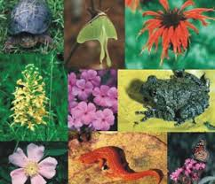
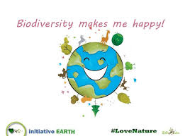
BIODIVERSITY & CONSERVATION https://www.youtube.com/watch?v=d9K0cZGQgHA
Navdhanya (Dr. Vandana Shiva)

Slide 2
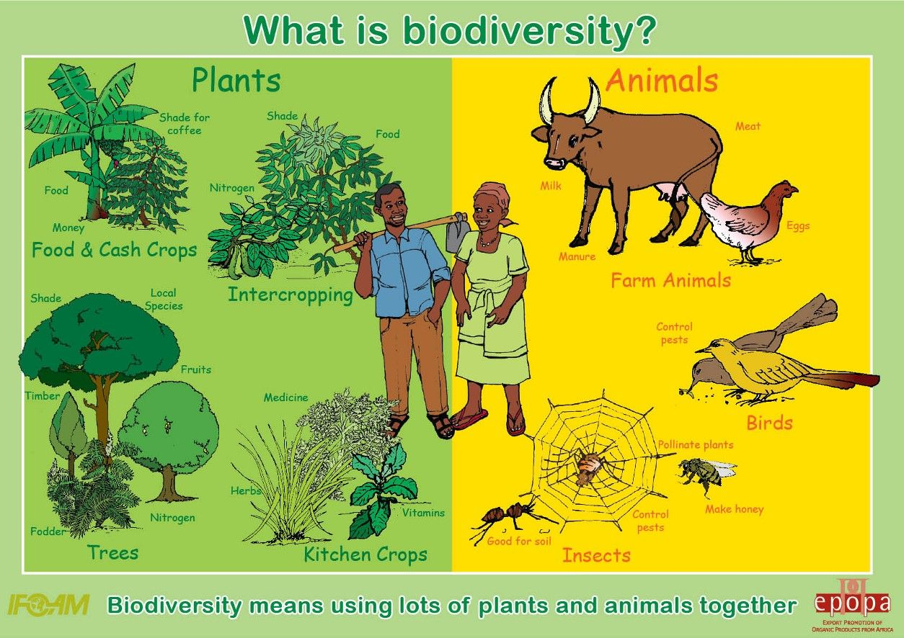
BIODIVERSITY
Biodiversity is variety of life on earth.
“The abundance of various species of plant,
animal & microorganism in natural environment
of specific region or country.”
“Biodiversity include
-variability of genes,
- variety
of species and population in different
ecosystem.”

Slide 3
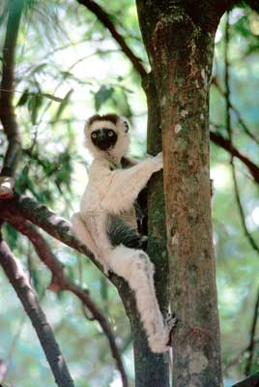

Slide 4
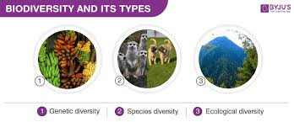

Slide 5
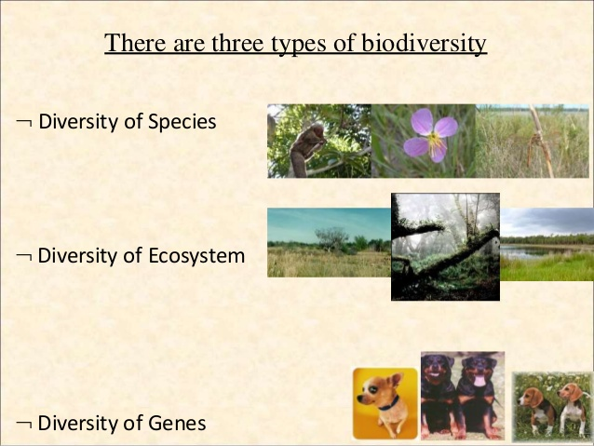

Slide 6
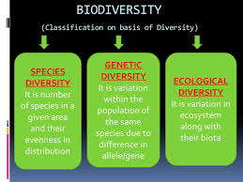

Slide 7
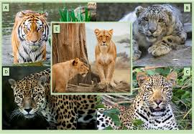
Classification of Biodiversity
1. Species diversity (Diversity of Species within community )
The biotic component of ecosystem is consist of large number of plant and animal species which interact with each other and also interact with abiotic component.
The richness of species in an ecosystem is called species diversity.
It is a variety in number and richness of species of a region .
For Eg. in grassland ecosystem there exist different species of plant and animal.

Slide 8
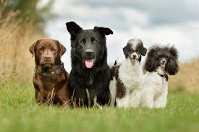
2. Genetic Diversity
It include amount of genetic variability among individual of same species or among different species.
In our ecosystem there exist large varieties of species which slightly differ from each other in one or more characteristics such as size, shape, resistance against pest, insect, pest disease.
It refer to variation of genes within species. Diversity in number and type of genes as well as chromosomes present in different species.

Slide 9
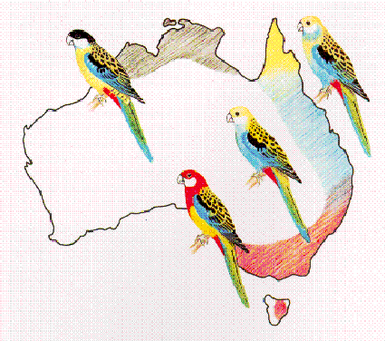
Genetic variation within the White-cheeked osella.Genetic variation within a species can express itself in many ways. The White-cheeked Rosella, for example, is made up of four varieties, each with its own distinct colour combination and markings.

Slide 10
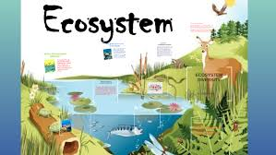
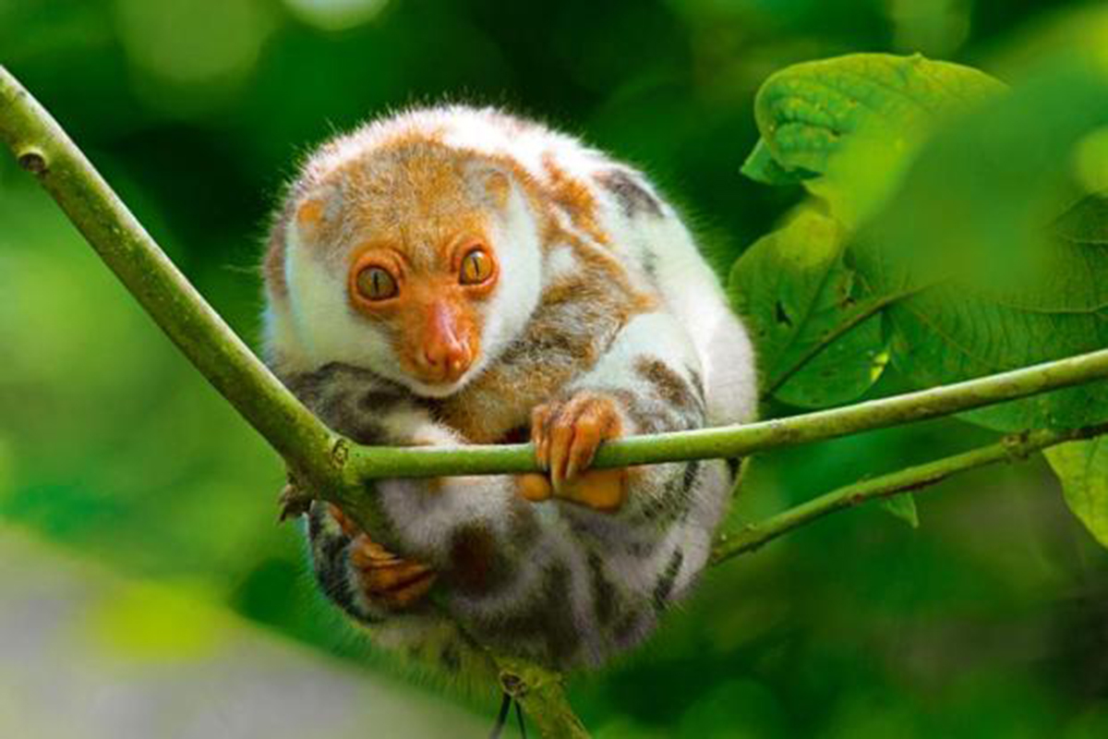
3. Ecosystem Diversity
Different type of forest, grassland, ocean, pond, lake represent diverse ecosystem which contain different variety of plant and animal.
This is the diversity of ecological complexity showing variation in ecological niches, trophic structure, food –webs, nutrient cycling.
The ecosystem also show variation with respect to physical parameter like moisture, temperature, altitude, precipitation.

Slide 11
Biodiversity at National Level India
India is second largest nation containing 5% of world’s biodiversity and 2% of the earth surface.
Rank of India in biodiversity:
10th rank among the plant rich
11th rank among the endemic species of higher vertebrates
6 th rank among the centers of diversity and origin of agricultural crops.
India’s is an agricultural country and economic depends on the production of crops
India is considered as mega – diversity nation because of rich in flora and fauna.
High demand in abroad for Indian speci

Slide 12
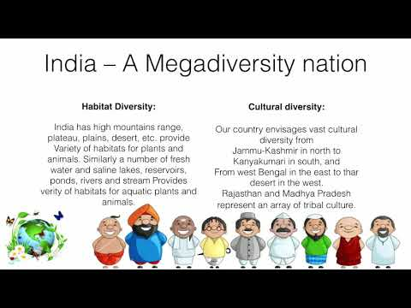
India as Mega Biodiversity
47000 species of plant
81,000 species of animal
( According to MoEF , Govt. of India (2000) records)
India is considered as a Mega Diversity region because it has wide variety of endemic flora and fauna.
India is one of the 12 mega –diversity countries in the world.

Slide 13
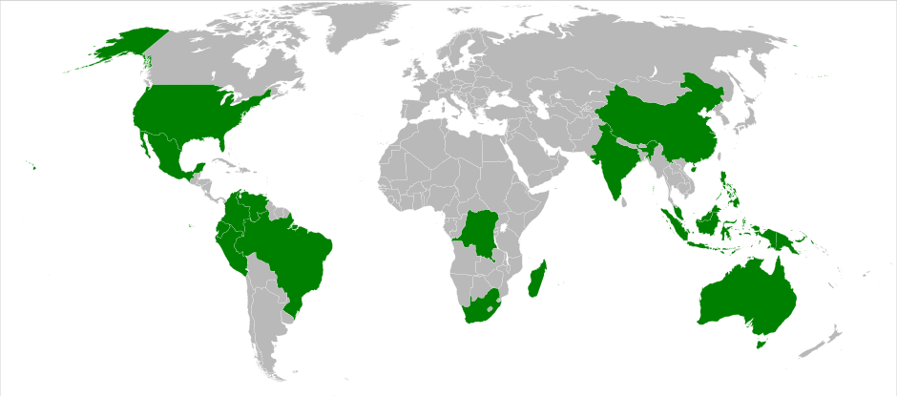
World Biodiversity region

Slide 14
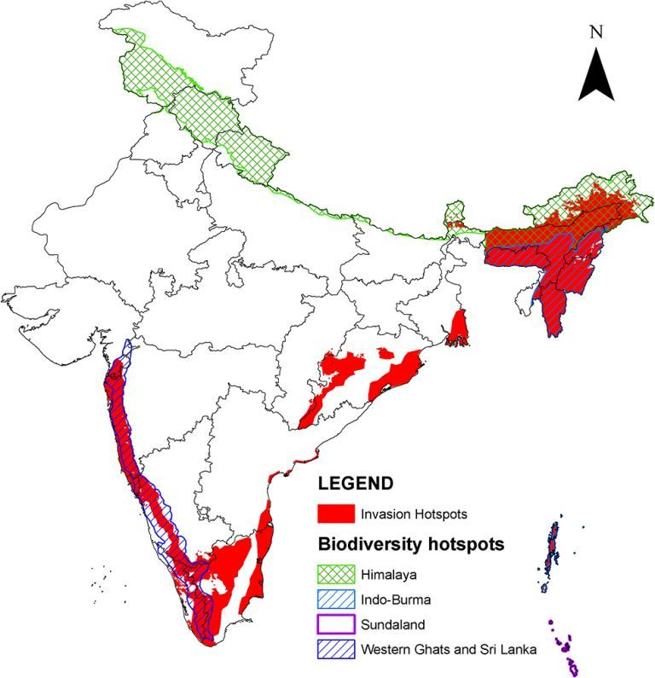
Hots –Spots Biodiversity
The area that are extremely rich in biodiversity that harbour a great diversity of endemic species and at the same time they have been significantly degraded by human activities.
Hots – pots region must satisfy the following condition
It must support 15000 endemic plant species.
It must support 70 % of its original habitat
Indias Hots – Pots are
Eastern Himalaya & Western Ghaat

Slide 15
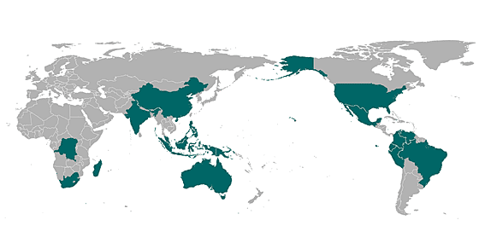
Hot Pots Biodiversity of the World

Slide 16
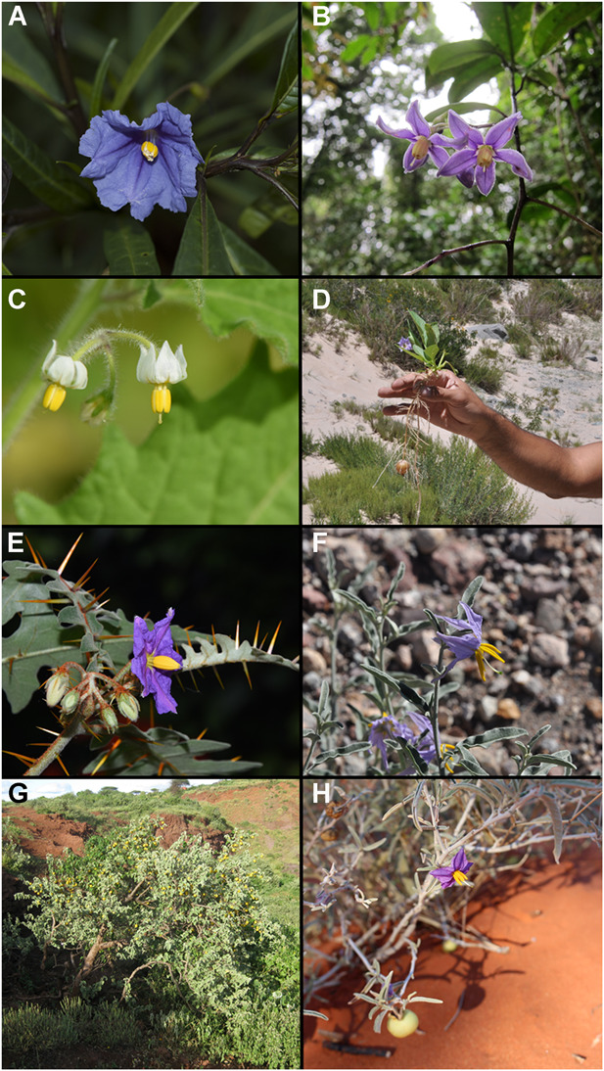
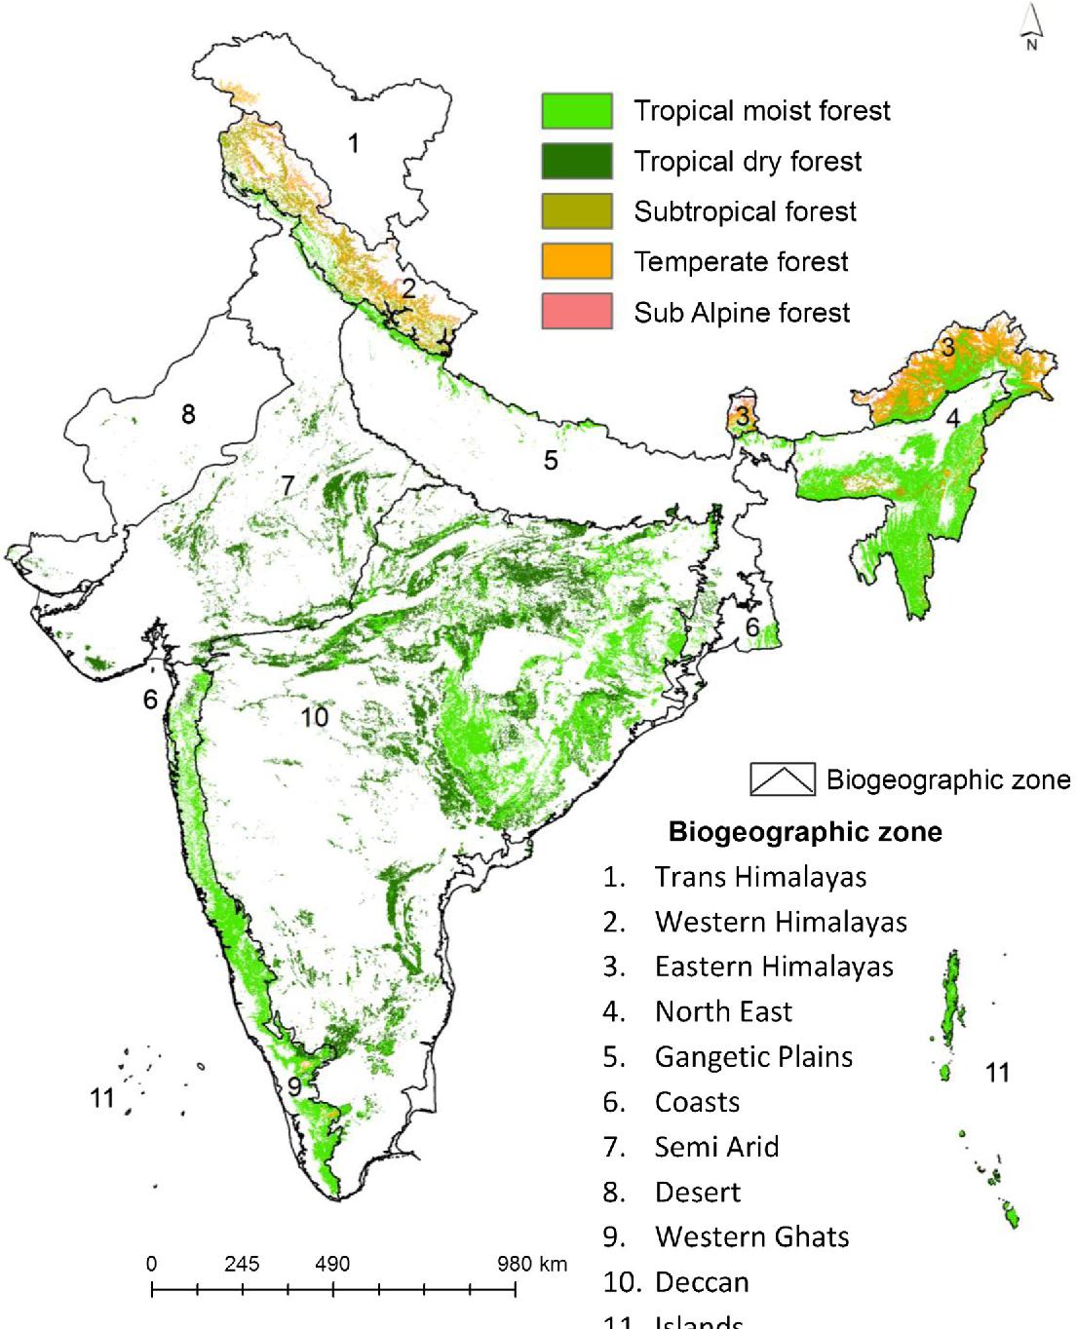

Slide 17
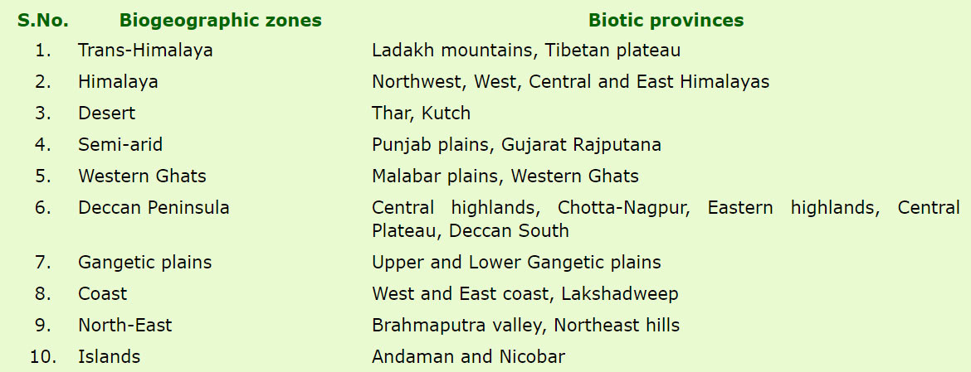

Slide 18
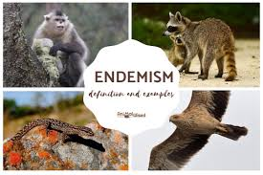
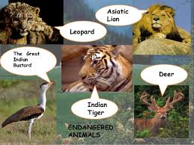
Endemic Species
India has two biodiversity hotpots and thus possess a large number of endemic species.
“The species which are confined to a certain region. It may be continent, country, state or even small ecosystem.”
Total Endemic species : 7000
Indian subcontinent has about 62%endemic flora , restricted mainly to Himalayas, Khasi Hills, Western Ghaat.
Species : Sapria Himalayan, Amphibian ( Frog & Tod) , endangered endemic Orchid of Eastern Himalaya

Slide 19
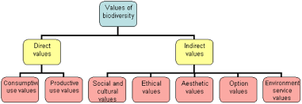

Slide 20
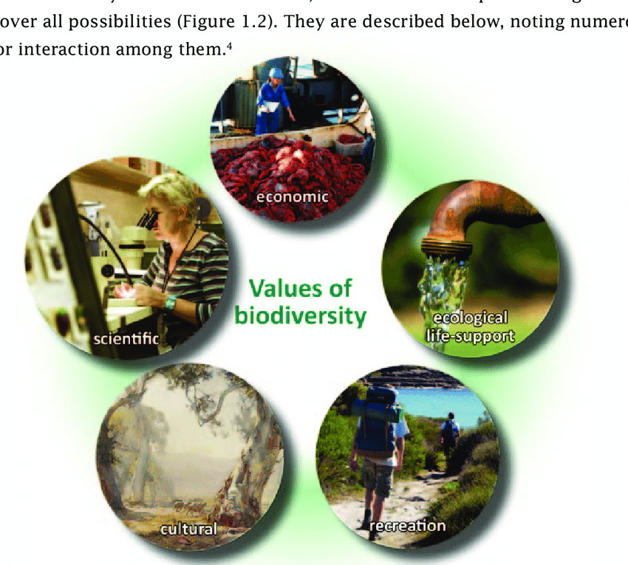

Slide 21
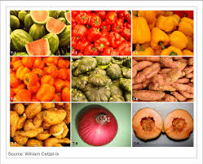
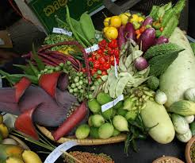
Value of Biodiversity
1.) Consumptive Use
Direct value where the biodiversity product can be harvested
and consumed directly e.g fuel, food , drugs and fibre
Biodiversity provide us food, timber, fiber, medicine, fuel etc.
i)Sources of Food:
Wild plant species are consumed by human being as food. Total
80,000 edible plant species has been reported from wild, out of
which 90% species have been domesticated from wild tropical
Plant.
Plant provide wide variety of food like maize, wheat, rice.

Slide 22
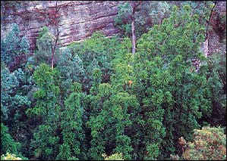
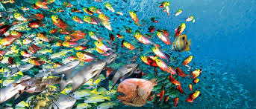
Animal: Man consume meat from mainly nine species of animal like cattle, ship, pig, goat, water buffaloes, chickens, duck, geese and turkeys. Fishes are now regarded as a domesticated animal because of development of aquaculture. Curd, cheese milk are obtained from dairy farms. Forest provide oxygen to consumers and play a very important role in maintaining ecosystem.

Slide 23
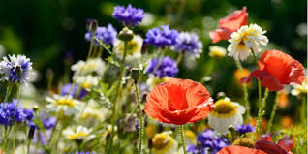
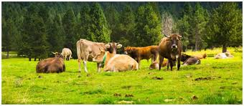
ii) Sources of Fats and Oil
Commonly used oil seed plant like mustard, ground
nut, palm oil.
The other oil like soyabean, binola(cotton
seed), sunflower are becoming popular.
iii) Fuel
Our forest have been used since ages for fuel wood.
The fossil fuels coal, petroleum and natural gas are also product of fossilized biodiversity.
Firewood is still used by villagers, tribals communities.
Fibres
Major fiber yielding varieties are cotton, flax, jute, sisal, coir, abaca.

Slide 24
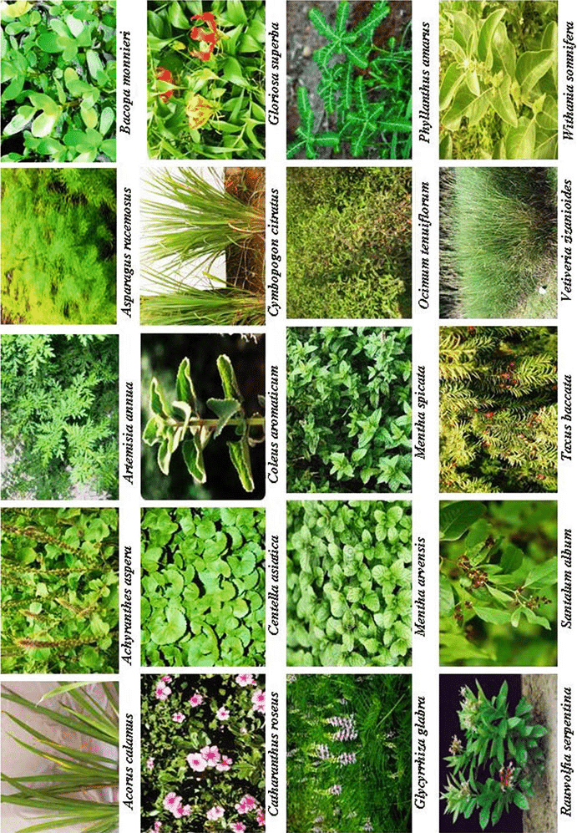
v) Drug and Medicine
A number of herb has been used to cure various ailments.
Various plant contain valuable drugs.
Eg. Rosy Periwinkle plant is used for treatment of cancer.
Tulsi has the property of antibacterial. Quinine is used
for the treatment of malaria.
The importance of herbal plant for ailment of various disease was discussed our ancient Scriciptual Ayurveda.
2. Productive Use Values
These are the commercially usable value where the product is marketed and sold.
Animal product : tusk of elephants, musk from musk deer,
Silk from silk worm, wool from sheep, fur from many animals.
b) Many industries e.g Paper and Pulp Industries, plywood industries, silk Industries, ivory works, leather Industry and pearl Industry depend upon product use value

Slide 25
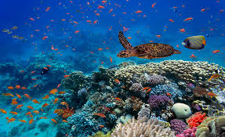
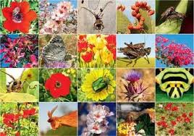
3. Social Values
These value associated with social life, customs, religion and spritiual aspect of people.
Many Plants speccies i.e. Tulsi, Mango, Lotus.
Tribal people closely linked with wild life species.
Animals i.e cow, Snake, Bull , peacock , owl
4. Beautification Value / Aesthetical values
Biodiversity provide lots of aesthetic and beautification value. Human being is fond of maintaining garden, keeping pets, ecotourism.
No one would like to visit stretches of barren land .
People like to visit wilderness areas where they enjoy esthetical value of biodiversity , this time of tourism known as “Ecotourism”
For example national park , zoological garden , sanctuaries to watch scenic beauties.

Slide 26
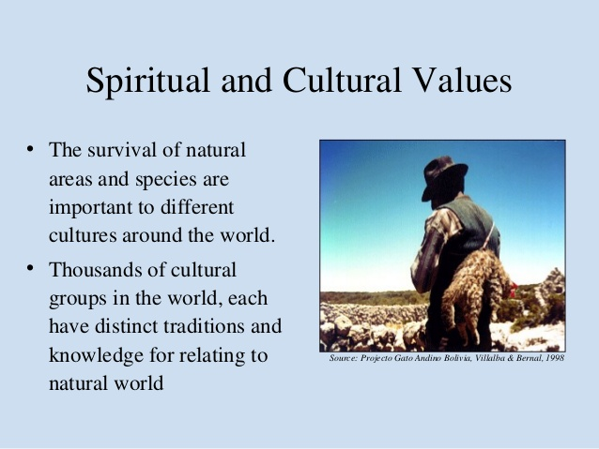

Slide 27
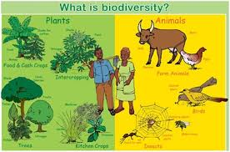
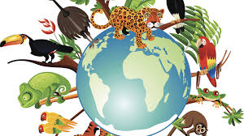
5. Cultural Benefit
Since the ancient time our culture and festival were associated with various plant and animals.
Eg. Banyan tree, Peepal, Tulsi has been worshipped by women of India. Banana tree some animal like cow is considered our mother.
Some animal and plant considered as a national symbol like
Peacoack, Tiger, Lotus, Banyan.
6. Option Value
These value include potential of biodiversity that are presently unknown and need to be explored.
Species can be used for the treatment of few disease i.e cancer

Slide 28
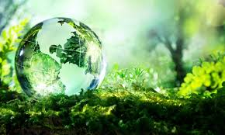
7. Ecological role of Biodiversity
Protection of Water resource
Forest and plant cover in water catchments area help
To maintain hydrological cycle.
Prevention of Soil erosion
Maintenance of soil fertility
Plant body provide organic matter to soil through decay.
Cycling of nutrient
Regulating and stablising water runoff.
Acting as a buffer against natural calamities like flood and drought.
Forest increase the water table.
Regeneration of natural spring.
Eg. Wet land and forest act as a water purifying system while mangroves
trap silt reducing impact of sea waves, tides or Tsunami.
Root system facilitate microbial activity and increase porosity of soil

Slide 29
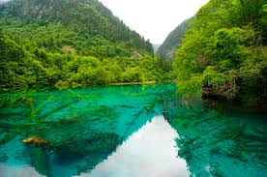
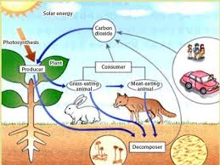
8. Maintenance of Ecosystem
All species are equally important in our ecosystem. Disruption of one species can lead to destruction of whole ecosystem.
According to food chain and food web all species of plant and animal are interrelated with each other.
For e.g Plant ---- deer------lion
If the population of lion is destroyed the population of deer can increase in excess and overpopulation of deer will eat up whole grasses in grassland ecosystem thus making into degraded ecosystem.
If the population of deer decreased it can lead to overgrowth of plant that will lead to competition between the various species of plants and in this way whole ecosystem can be degraded.

Slide 30
9. Scientific Value
The study of wildlife provide valuable knowledge about various life process.
Such studies has helped scientist to understand how the human body function.
Scientist have also gain medical knowledge and discovered important medical produced by studying wildlife.
10.Survival Value
Every species of wildlife play a very important role in maintaining the balance in ecosystem. Thus the loss of any species can threatened the survival of al life including human being.
Eg.
Kelp Sea Urchin Sea Otter

Slide 31
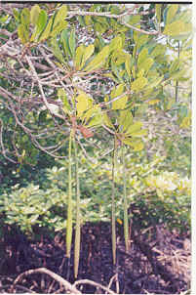
Mangroves
Are salt-tolerant forest ecosystems found mainly in tropical and sub-
tropical inter-tidal regions of the world.
They are trees or shrubs that have the common trait of growing in shallow and muddy salt water
or brackish waters, especially along quiet shorelines and in estuaries.
They exhibit remarkable capacity for salt water tolerance.

Slide 32
Flora
India can be divided into 8 distinct floristic region namely
Western Himalaya
Eastern Himalaya
Assam
Indus plain
Ganga Plain
Deccan
Malabar
Andaman
The Western Himalaya region extend from Kashmir to Kumaon.

Slide 33
Fauna
As India has such a huge variety in climate and physical condition it has a great variety of fauna numbering 89,451 species.
Mammals include Majestic Eelephant, India Bison,Ggreat Indian Rhinocerous, Wild Sheep of Himalaya, Swamp Deer, Tiger, Lion, Leopard, Kashmir Stag .
Forest and wetland are inhabited by bird like pheasant, geese, duck, cranes, horn bils and sunbird.
River habour crocodile and ghariyals.

Slide 34
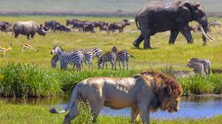
Loss of Biodiversity
A number of species of plant and animal are going to extinct. Many species have been extinct.
Different factor are responsible for extinction of various species like
1. Habitat loss and fragmentation
2. Disturbance and degradation,
3.Pollution,
4. Introduction of exotic species
5. Intensive agricultural , forestry
6. overexploitation of natural resources.

Slide 35
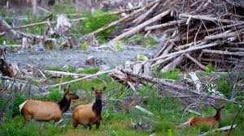
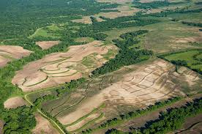
1. Habitat loss and fragmentation
Increasing population is leading to urbanization and industrialization
which require more land every year.
There is destruction of natural habitat through filing of wetland
cutting tree, ploughing grassland , burning forest.
There is destruction of natural habitat through filling of wetlands ,
cutting tree, ploughing grassland and burning forest.
2. Disturbance and degradation
Natural disturbance like flood, earthquake, forest fire,
pest infestation like coast attack
Man made disturbance - like felling of trees, litter accumulation
pollution lead to degradation of habitat and loss of biodiversity.

Slide 36
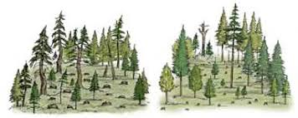
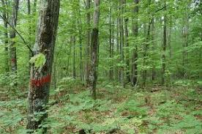
3. Selective Forestry:
Due to profit motive there is tendency to grow economically lucrative
tree for economic benefit. Eg. Saal, Teak, Equalyptus Due to this
tendency other species are driven away from the area.
4. Over Exploitation
Due to overexploitation of natural resources some time many species
become endangered and vulnerable which may extinct in near future.
5. Intensive Agriculture
Grassland , forest and wetland are destroyed to make way for
cultivation of land.
Destruction of biodiversity mainly caused by
excessive use of chemical fertilizer and pesticides.
Application of Hybrid varieties of plant which are genetically modified
that resulted loss of traditional varieties.

Slide 37
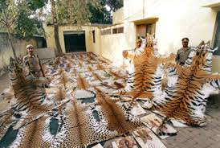
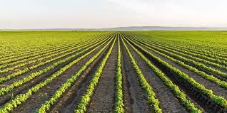
6. Poaching
Trade pay large amount of money to poacher and smuggler.
Trade for live specimen , furs, hides, skin.
Although strict law have been made yet these product are
widely traded.
Extinction of Species
Extinction mean total elimination or dying out of species from earth.
7. Increasing monoculture
Growing only one kind of crop also lead to extinction of various species.
Instead of practicing monoculture we should promote mixed farming, intercropping, crop rotation, mixed cropping.

Slide 38
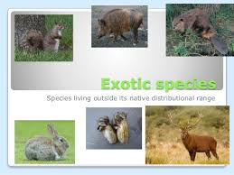
8. Introduction of exotic or foreign species
Sometimes foreign or alien species are introduced on land
for economic gain.
They gain ground and drive away the local species.
9. Pollution
Excessive use of pesticides pollute the water which
prove harmful to certain species.
Runoff fertilizer may lead to Eutrophication.
- Air pollution
Soil Pollution
Water pollution cause
deleterious impact on various species of flora and fauna.

Slide 39
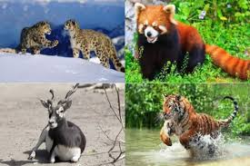
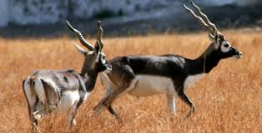
Endangered Species
These are species whose number has been reduced alarmingly. Their habitat has been reduced drastically and they are immediate danger of extinction.
Vulnerable Species
These are the species that are under constant threat and may become endangered if the same condition persist.
Rare Species
These are the species which are at risk of danger but these are not endanger species. Rare species are not endangered. They may scattered thinly over an extensive range.

Slide 40
BIODIVERSITY AT LOCAL LEVEL
Based on the spatial distribution the biodiversity at local level is classified as follows,
Point richness
Species found in single point in a given place
2. Alpha richness or Alpha diversity
Number of species found in small homogeneous area
3. Beta richness or Beta diversity
Rate of change of species increase as more heterogeneous habitats
4. Gamma richness or Gamma diversity
Changes across large landscape BIODIVERSITY IN TAMILNADU
Distribution of plants and animals among different districts in

Slide 41
Threatened Species
Any species which falls any of above three categories is known as threatened species.
Some species that have been put under the category of endanger are
Mammal : Black buck, Asiatic Lion, Bengal Tiger, Dolphin, Red Panda, Red Fox
Bird : Indian Peafowl, Mute Swan, Eastern Crane,
Monal, Great Indian Bustard, peacock pheasant,
Black eagle vulture
Reptiles : Marsh crocodile, Monitor Lizard, Trunk Turtle
Amphibian: Indian Salamander, Viviparous foos

Slide 42
Conservation of Biodiversity
It is necessary to maintain a balance between utilization of natural resources and conservation of natural resources.
Conservation mean wise and judicious use of natural resources so that not only our present generation but future generation will also meet their needs.
Conservation means most efficient and most benefit utilization of natural resources.
In order to conservation of species we should promote Sustainable Development.

Slide 43
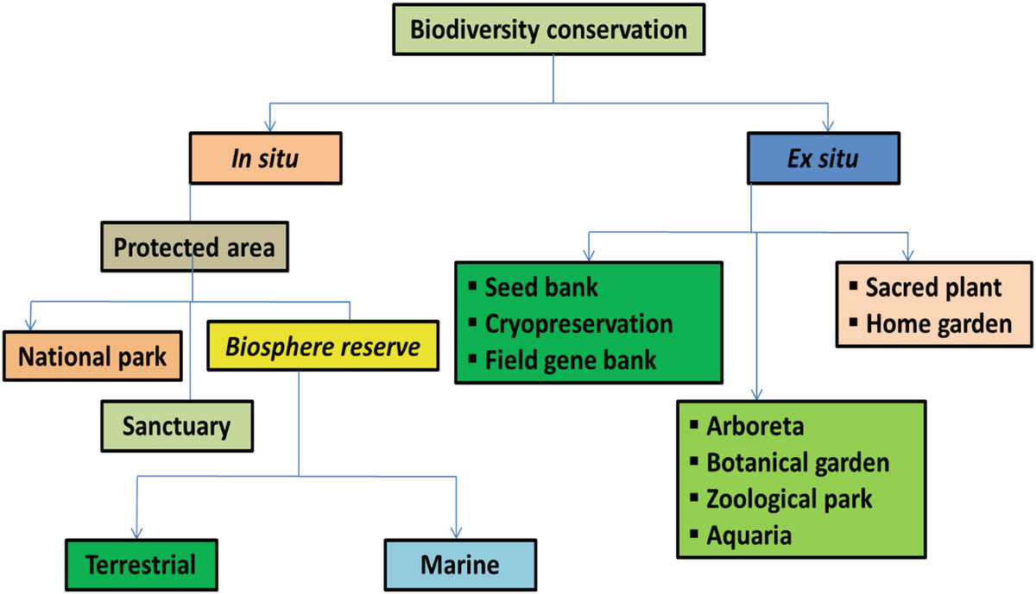

Slide 44

CONSERVATION
1. In-situ conservation
2. Ex- situ conservation
In-situ Conservation:
In- situ conservation means the conservation of the species in it
natural ecosystem.
In –order to promote in–situ conservation protected area have been developed like
national park, sanctuaries
and biosphere reserve etc.
National Park
It is habitat oriented. It has been developed for the conservation of habitat of particular species

Slide 45


National Park
Activities like forestry, grazing and cultivation are not permitted here.
No private ownership of land is allowed here.
National park usually devoted to habitat and betterment of particular wild species like Tiger, Lion
Limited human activities is allowed in buffer zone but no biotic interference is tolerated.

Slide 46


Sanctuary
This is more generally species oriented as for Great Indian Bustard and Pitcher Plant
Human activities like collection of fuel , fodder, litter are allowed
but they should not interfere life of animal.
Biosphere Reserve
Biosphere programme have been launched under MAB (Man
and Biosphere Reserve Programme in 1971.
It is ecosystem oriented.
It is a special category of protected area of land devoted to totality of all term of life.

Slide 47


It may be divided into three categories
1. Core Zone :
This area is legally protected and remain undisturbed.
2. Buffer Zone
It can be used educational activities and research.
3. Transition Zone
Here is active co-operation between reserve manager and local inhabitant.
All kind of activities can take place here provided that they do not disturb the harmony of Biosphere.

Slide 48


Slide 49


Slide 50


Slide 51


Ex-situ Conservation
Conservation of the species from outside their natural habitat .
In other word it is conservation in captivity under human care.
The endangered species of animals are collected and bred under controlled condition in Zoo, Farm and Aquarium.
Plant Species are kept in botanical garden.
Botanical Garden
Zoological Garden
Seed Bank
Pollen Storage

Slide 52
International Effort in Biodiversity Conservation In 1980 three organization UNEP, The world conservation Union and WWF prepare a world conservation strategy. Its plan - to conserve biodiversity - Preserve vital ecosystem process on which all plant life depends for survival. - Develop sustainable uses of organism and Ecosystem. - In 1991 they publish new version the document called “ Caring for Earth” - They Conducted conference like Earth Summit - CITIES (Conventional on International Trade and in Endangered Animal and Plant Species ( This conventional has been forced since 1975 and more than 150 countries signed it. - CITIES has helped reduce trade in many threatened species including elephant, crocodile and chimpanzees. CITES (the Convention on International Trade in Endangered Species of Wild Fauna and Flora) is an international agreement between governments. Its aim is to ensure that international trade in specimens of wild animals and plants does not threaten their survival

Slide 53
Convention on Biological Diversity, key international instrument for sustainable development
The Convention on Biological Diversity (CBD) is the international legal instrument for "the conservation of biological diversity, the sustainable use of its components and the fair and equitable sharing of the benefits arising out of the utilization of genetic resources" that has been ratified by 196 nations.
Its overall objective is to encourage actions, which will lead to a sustainable future.
The conservation of biodiversity is a common concern of humankind. The Convention on Biological Diversity covers biodiversity at all levels: ecosystems, species and genetic resources.
The CBD’s governing body is the Conference of the Parties (COP). This ultimate authority of all governments (or Parties) that have ratified the treaty meets every two years to review progress, set priorities and commit to work plans.

Slide 54
What has India done under the Convention on Biodiversity
In May 1994, India become a party to CBD.
In January 2000, the government release National Policy and Action Strategy on Biodiversity.
NBSAP (National Biodiversity Strategy and Action Plan was prepared during 2000 -2003.
Key element are
Restoration and regeneration of degraded ecosystem.
Development of alternative intellectual property right system appropriate for indigenous knowledge.
Respect for Cultural diversity
Prevent deprivation of indigenous people from natural resource.

Slide 55
Watch Video of Dr. Vandana Shiva https://www.youtube.com/watch?v=gof7vdQI6OM (Importance of Seed) https://www.youtube.com/watch?v=c3dVhbnIRGM

